Slide 1
PnP Community Information –February 2015 SSUG Stockholm
aka.ms/OfficeDevPnP
aka.ms/OfficeDevPnPYammer
Patrik Björklund @pbjorklund

Slide 2


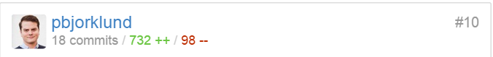
Me
Patrik Björklund – @pbjorklund
patrik@allocit.com
Independant consultant
!Erwin
Notes:
Nr #10 contributor to the PnP project
Erwin could not make it, asked me

Slide 3
Questions I will (hopefully) answer in the 26 remaining slides
What is PnP?
What does PnP contain?
What value does PnP provide?
How do I get involved?

Slide 4


Transform your code Providing App Model Patterns for common Full Trust Code scenarios
100+ Visual Studio projects Common scenarios
Branding
Site provisioning
Remote event receivers
Large file support
Taxonomy driven navigation
And much more…
Contribute
This is open source project and open for contirbutions
Developer
Patterns & Practices
aka.ms/OfficeDevPnP
Notes:
PnP started as a library of reusable code in an internal MS project. JDP (Joint Development Program), where MCS people shared code to be reused between their customers.
Turned into Office AMS.
Turned into PnP.
Provides guidance on how to transition from FTC to the app model and how to solve common scenarios in an App Model world (o365 apps are making their way into the project as we speak).
On top of this it also aims to make development on O365 a better experience.
Core team consists of a group of Microsoft employees along with a few community members (all MCMs atm) with Vesa Juvonen at the helm.
Core team does this in their free time, the same as the rest of the community.

Slide 5
The PnP Repository
https://github.com/OfficeDev/PnP

Slide 6
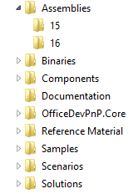
PnP Structure – folders and code
All referenced assemblies are included in package.
Contains latest 15 & 16 versions of the CSOM components.
No need for additional downloads
Reusable components targeted for reuse as such in projects.
Various Presentations on different scenarios.
Reusable remote operation component with extensions methods to standard CSOM objects.
Sample projects. Independent samples demonstrating a capability or functionality.
Scenario demonstrations for the usage of the core component. Contains additional explanations and usage models for API patterns.
Complex reusable solutions demonstrating combining multiple capabilities for building real solution. Uses core component.
Notes:
Walk through the dirs. Show a few examples after this.
Assemblies: Latest 15/16
Binaries: PS installer
Components: standalone components, easy to integrate into apps
Doc: ppts about app model
Core: extension methods. Single line. Will show later.
Reference: Old FTC solution to use in training, demos for FTC-> cloud
Samples: Small demo proj to show how to solve common problems. Not dependant on Core
Scenarios: Shows how the Core library can be used
Solutions: Shows more complex solutions.
New:
Guidance: moved to own repo. Can now end up as MSDN articles!

Slide 7
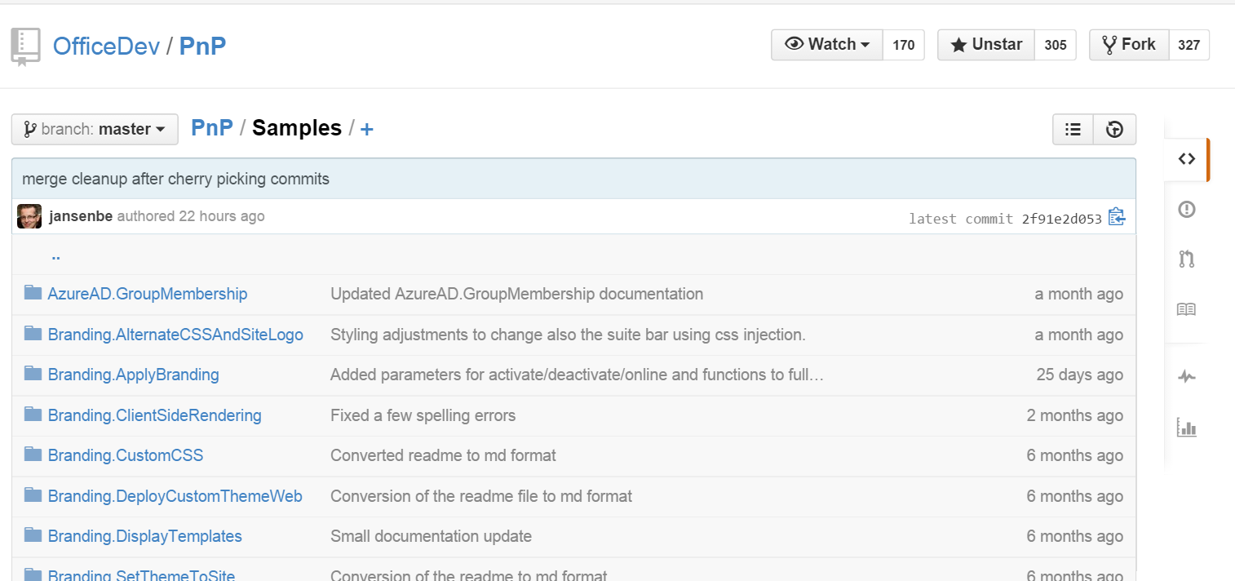
PnP Samples
[… A lot more]
Notes:
Small demo proj to show how to solve common problems. Not dependant on Core
Branding.SetThemeToSite – Apply theme to site
Branding.DisplayTemplats – Mobile friendly display template in CSWP
Cure.BulkUserProfileUpdater – Bulk update from CSV, extract from LDAP with auth
Core.LargeFileUpload – Upload large files
Core.PermissionsListing – Pull permissions from sitecollection
Also demos Workflows, Provisioning, Search, OfficeGraph, Office 365 apis etc

Slide 8
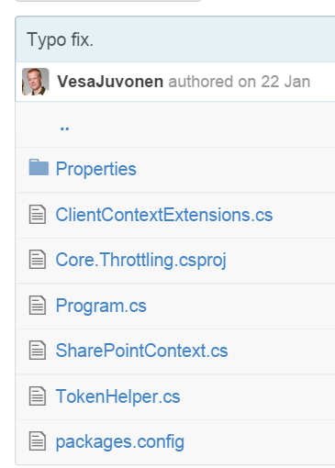
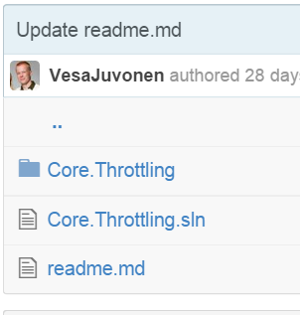
PnP Samples - Core.Throttling
Notes:
Reference code
Shows pattern on how to handle possible SharePoint Online throttling which could be applied for CSOM, REST and web service operations in the SharePoint Online.

Slide 9
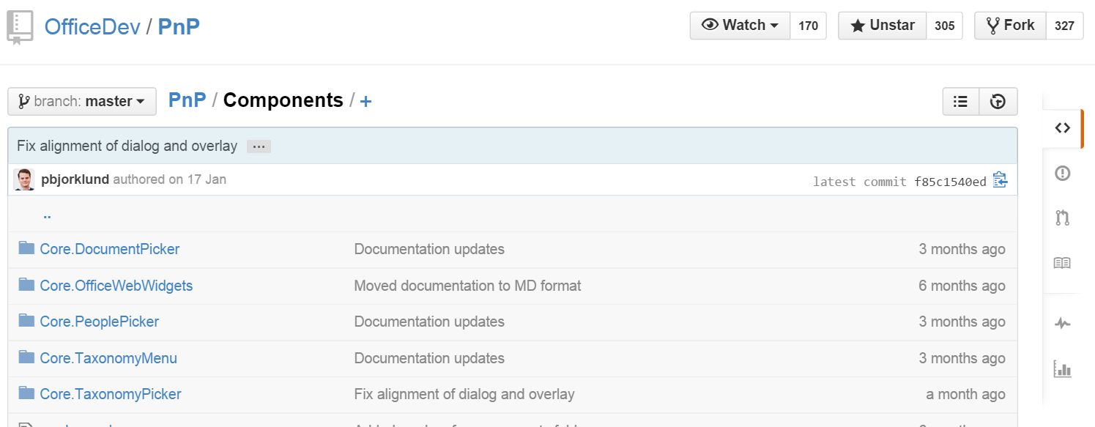
PnP – Components
Notes:
Components: standalone components, easy to integrate into apps

Slide 10
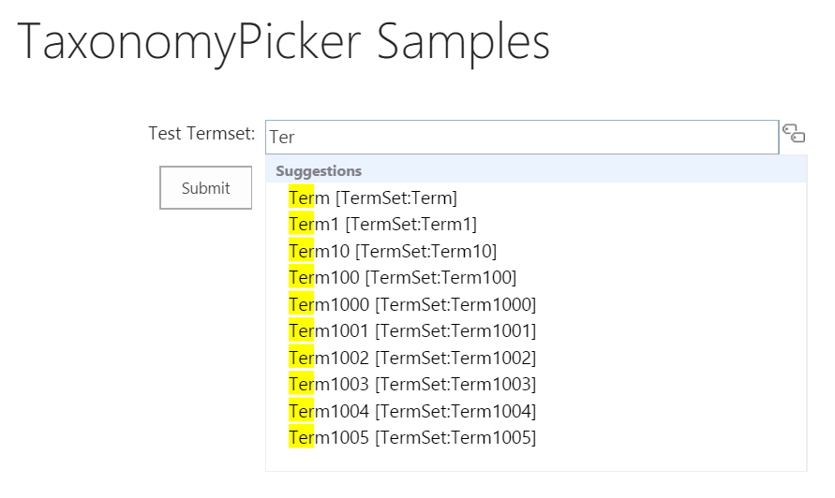
PnP – Components – TaxonomyPicker
Notes:
In provider hosted apps we don’t get the SharePoint controls we are used to. Reinventing these would take us quite a while, thankfully Richard diZerega thought about this and made a component using just javascript and css.
Fuzzy finding

Slide 11
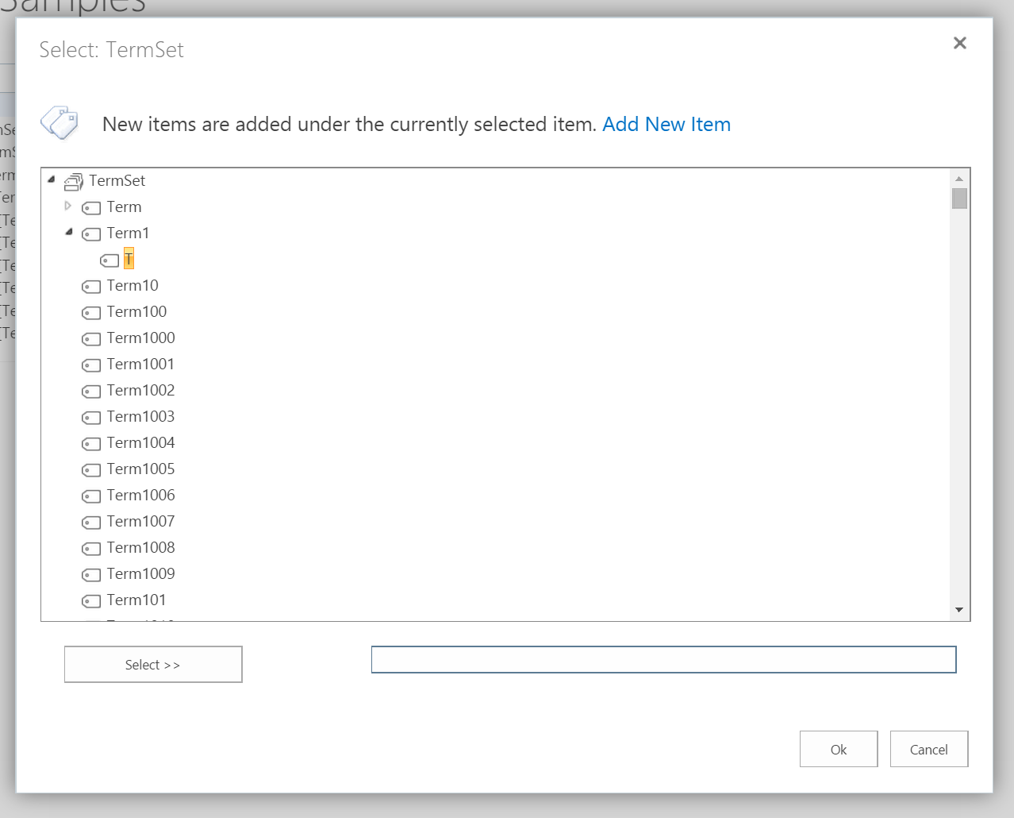
PnP – Components – TaxonomyPicker
Notes:
Dialog
Also have
Peoplepicker
Documentpicker
Localized taxonomymenu

Slide 12
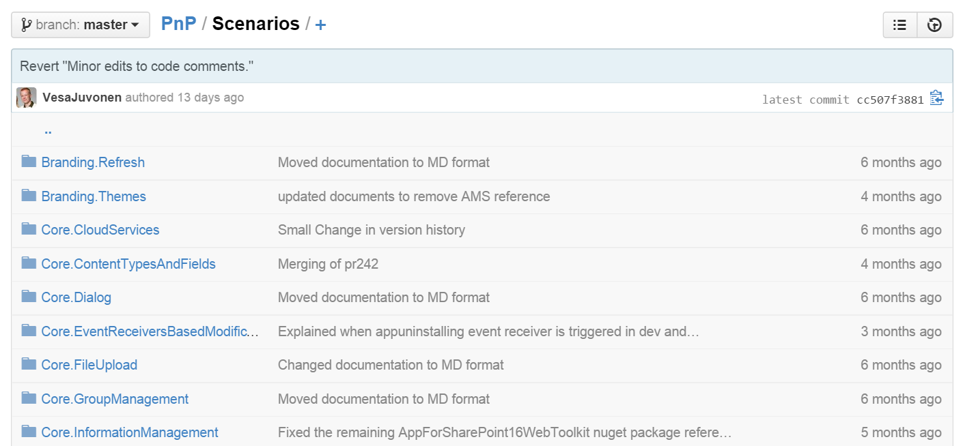
PnP – Scenarios
[…]
Notes:
Scenarios: Shows how the Core library can be used
Core.Dialog – Shows how to show an app inside a dialog
Core.FileUpload – Upload large file from within sharepoint app
ECM.AutoTagging

Slide 13
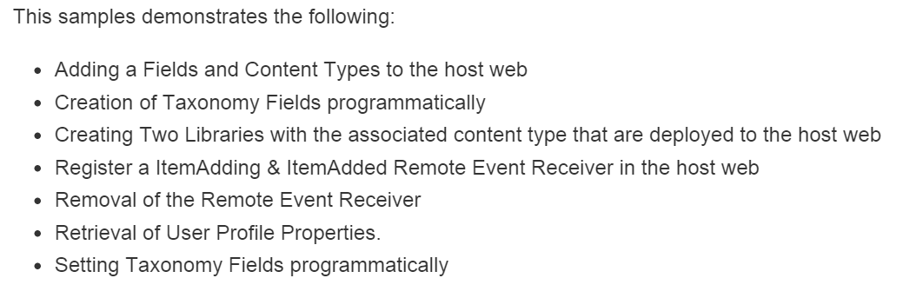
PnP – Scenarios - ECM.AutoTagging
Notes:
Client has requirement: We want autotagging of items uploaded here based on looking up a record in a database. We want to append a userprofile prop

Slide 14
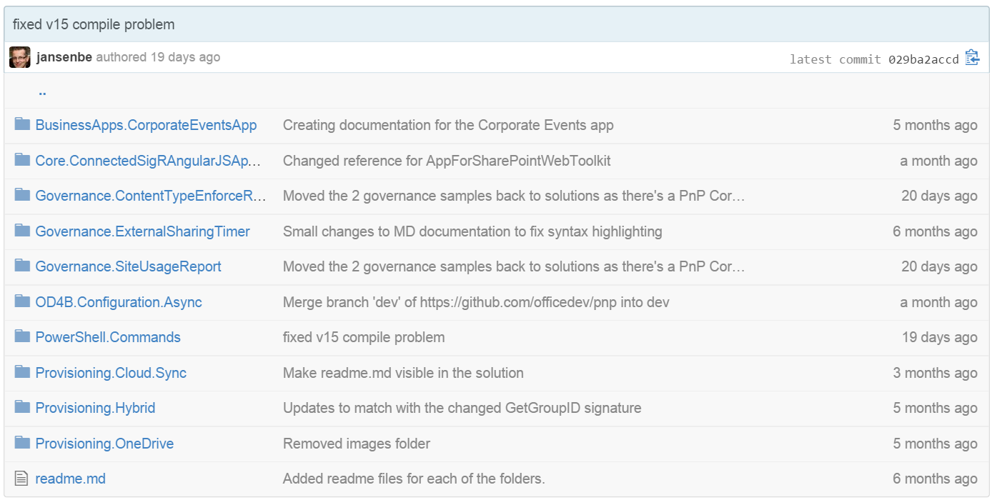
PnP – Solutions
Notes:
Solutions: Shows more complex solutions.

Slide 15
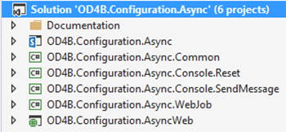
PnP – Solutions - OD4B.Configuration.Async
Notes:
App – Tenant FullControl, UserProfile FullControl
Common – Business logic, DTO for storage queue
Reset - !webjob version of solution, for testing OD4B config
SendMessage – to test storage queue mechanism
WebJob – Reads queue, acts
Web – Posts messages to queue, checks for cookie to determine wether or not to run it
How to transition to next slide?

Slide 16
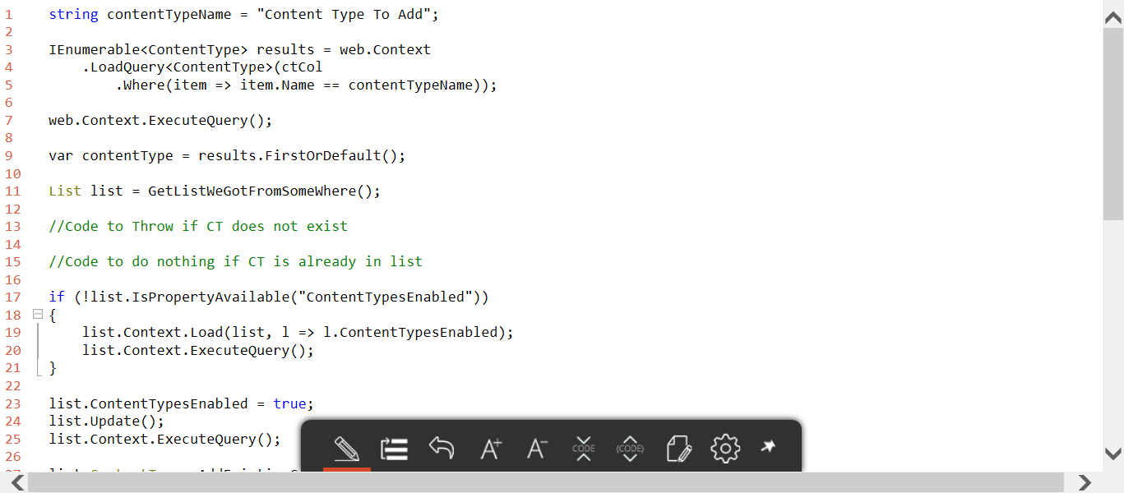
PnP – (Add CT to List w/o OfficeDevPnP.Core)
Notes:
Also extending with more platform patterns, for instance a “cloud version of TimerJobs” very soon that devs can pick up and use as replacement for on prem timerjobs.

Slide 17
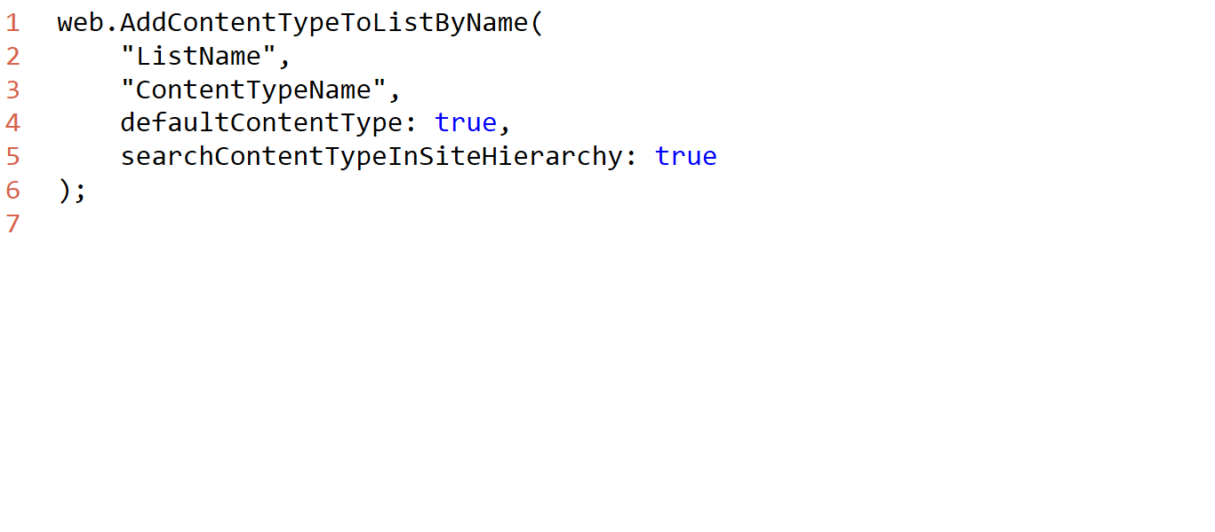
PnP – (Add CT to List w OfficeDevPnP.Core)
Notes:
This illustrates the core problem that Core started to solve. Eliminating error-prone boilerplate and tedious code.

Slide 18
PnP - Added value

Slide 19
PnP Value - Architect
Microsoft sanctioned solutions for common scenarios
Thoroughly integration tested extensions
Monthly releases through nugget
Save time and mental capacity
Notes:
MS sanctioned solutions to solve common problems/scenarios, can save a lot of development time. Thouroughly integration tested extensions with montly NuGet releases.
I check solutions/samples before google when not sure about the best approach. It has worked out really well in my previous 1 year long project.
Things from Core can trickle up into the CSOM api. SetSiteLogo turned up as web.SetSiteLogoUrl.
Deprecated when happens.
In future – Deprecation will state when deprecation will happen.
Keep it up to date

Slide 20
PnP Value - Developer
Core - Less boilerplate, DRY, trust the code quality
Opportunity to contribute back to the community
Notes:
Core - Write less boilerplate code. Trust the code that is written
Opportunity to share fixes back to the community (note: needs customer approval).
DRY / Don’t' reinvent the wheel. Focus on building solutions that provide value

Slide 21
PnP Value - Business
Save money. Sometimes a lot of money
Best practice
Notes:
PnP can save you a lot of money. This is where a lot of the best practices are formed

Slide 22
PnP Value – End User
Common Experience across domains and projects
Shorter time to market -> shorter time to solution
Notes:
Relying first on PnP components can give a common experience across domains and projects, no matter the development team. *if PnP is recommended by the business

Slide 23
Getting involved

Slide 24
PnP Repo Statistics(January 2015)
Forked 227 times (190, 135)
280 merged pull requests (236, 189)
67 closed issues (58, 43)
More than 2566 (3050, 2160) unique visitors during last 2 weeks – holiday season
Nuget package 4030 downloads (3800)
Yammer group has 1525 members (1419, 757)
aka.ms/OfficeDevPnPYammer
Facebook page has 121 likes (some to go still for Office AMS numbers)
https://www.facebook.com/OfficeDevPnP
Notes:
More forks than the Azure .NET SDK

Slide 25
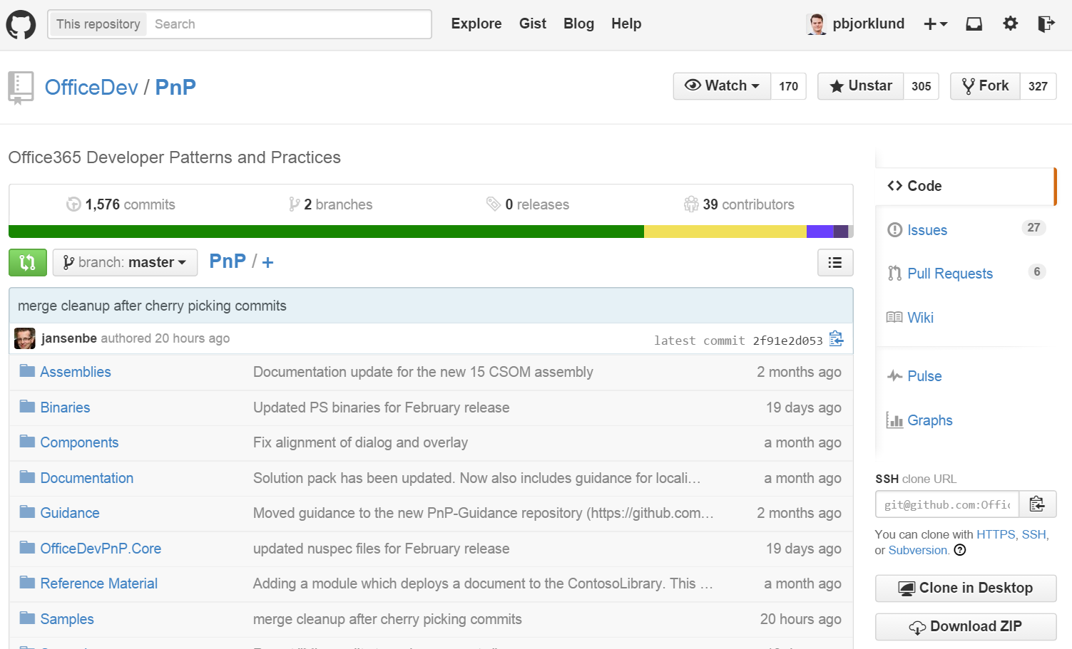
PnP Repo
Issues – File one or solve one
Pull requests – Contribute
Wiki – Learn, read
Notes:
GitHub – MS moving more and more to GitHub.
Name implies git. Can use github for windows, git in visual studio or git on the command line.
I prefer command line.
Issues – you all know
PR – fix something/add something
Wiki – Learn about the PnP project, how to get started, community call schedule, etc
Master merge first Friday of the month

Slide 26
How to contribute?
Documentation in wiki
https://github.com/OfficeDev/PnP/wiki/contributing-to-Office-365-developer-patterns-and-practices
Simple steps
Fork
Apply changes and contributions
Submit a pull request
Core team members will review
Merged to Dev
Notes:
http://www.git-scm.com/book/en/v2

Slide 27
Community calls
Vesa talks for 30-45 minutes, rest of the hour is demos and questions
Monthly call on 2nd Tuesday on each month
Next call is March 10 @ 17:00 (Lync link in PnP wiki)
Notes:
Calls are “muted” no-one has to talk. Talking is optional in last part

Slide 28

Roadmap – What’s coming?
Starter kits
Provisioning
Remote timer jobs
Improvements to core component
Unit testing, logging, other stuff
Guidance
Application Life Cycle for app model
Design patterns for App model based implementation
Transformation guidance for existing customizations
App model impact for enterprise architecture
Content migration for app model implementation
Continuous integration

Slide 29
Feedback…
Please keep the feedback coming in Yammer… we need your input for the prioritization.
Yammer group O365 Dev Patterns & Practices @ yammer.com/itpronetwork/
Notes:
Priority on planned topics
More code samples
Add core component capabilities
Reusable presentation material
Documentation on patterns and practices for app model (ALM ec.)
More complex solutions
More Office Client apps
More JavaScript app
Length: 30 second for this slide
Instructor notes
The following slides will walk you though the Lync tools that we will use in this class.
You will use all of these tools later in the class
Stress that your students will be able to run much more engaging meetings if they use these tools in their own Lync Meetings.
Course Development Notes:

Slide 30

Questions?

